Slide 1

COURSE TITLE :SOFTWARE DEVELOPMENT PROJECT-I
COURSE NO:CSE-2100
FILE SYSTEM WIZARD
Khulna University of Engineering & Technology

Slide 2
DEVELOPED BY
Md.Asaf-Uddowla Golap
Roll no:1207005
Nasrin Akter Rima
Roll no:1207048
SUPERVISED BY
Prof. Dr. K. M. Azahrul Hasan
Department of Computer Science & Engineering
Khulna University of Engineering and Technology

Slide 3
Contents
Introduction to File system Wizard
The making of File system Wizard
The building blocks of File system Wizard: the Classes
The control Flow diagram
A brief Explanation
Applications of File system Wizard
Limitations of File system Wizard
Improvement
Conclusion

Slide 4
Introduction to File System Wizard
An application written in Java programming language
An application to copy/move/delete computer files in large number efficiently

Slide 5
File System Wizard
Manager
MainWindows
CopyMoveAction Windows
Table Model
Files Table Model
DeleteAction Windows
Copier
TargetFile Chooser
Mover
File Chooser
Deleter
HomePage
The project consists of
2 packages
10 classes
Around 100 methods

Slide 6
The Control Flow in File System Wizard

Slide 7
Homepage
The starting point of the application
Table Model
File Chooser
Files
Start
Select Source?
Files selected by user
Files Sets on table Table
Delete?
Main Window
The hub of the application
Copy/Move ? ?
Delete Windows
CopyMove Windows
Delete selected
files
Copy/move selected
files
Copy ?
Move ?
Deleter
Copier/Mover
Copy/Move/delete
User selected Files.

Slide 8
Applications of File System Wizard

Slide 9
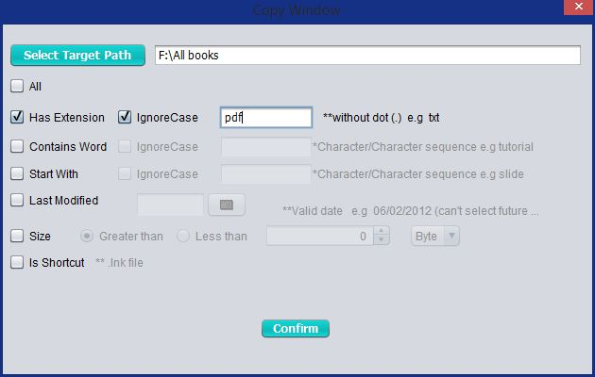
Extension
If the extension given by the user matches with the selected files extension then the action performed .The extension given by the user can be made case-sensitive or case-insensitive.

Slide 10
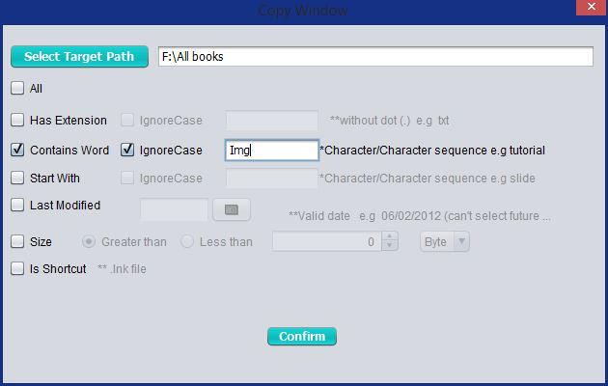
Contains character or character sequence
If the character/ character sequence given by the user matches with the selected files name extension then the action performed .The extension given from user can be made case-sensitive or case-insensitive

Slide 11
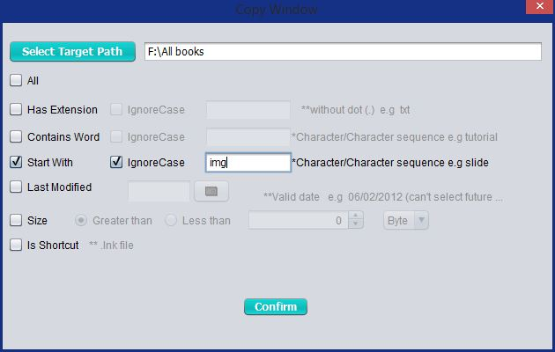
Start With
If the character/ character sequence given from the user matches with the starting of selected files name then the action performed .The extension given from user can be made case-sensitive or case-insensitive.

Slide 12
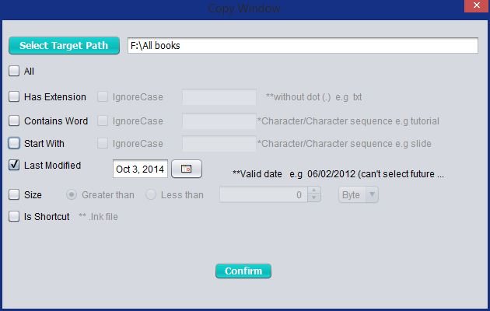
Last Modified
If the date selected by the user matches with the selected files last modified date then the action performed .

Slide 13
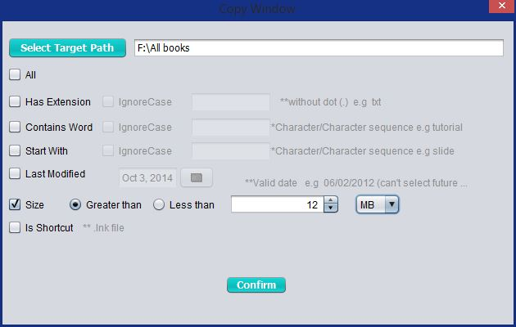
Size
The user can set a lower-limit or upper-limit on file-size for those to be copy/move/delete.

Slide 14
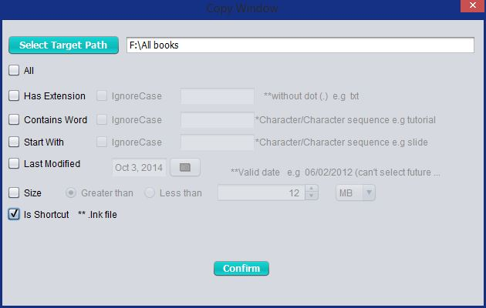
Shortcut:
If the files are shortcut the copy/move/delete action performed.

Slide 15
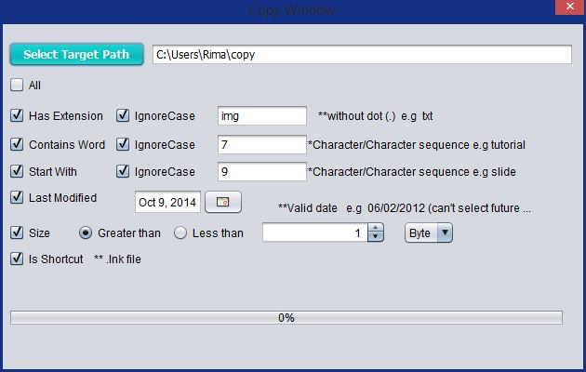
All option can be selected simultaneously

Slide 16
Limitations of File System Wizard
The action once done can not be undone.
If the file already exists in target directory or same name file exists in target directory that file will be replaced with new file.
If there exist some selected files in the tablemodel and we again select some new files, then the existing files will be replaced by the new files.
More time consuming .

Slide 17
Possible Improvements
Undo option should be added to undo action performed before.
If the file already exists in target directory or same name file exists in target directory There should be an option to the user whether he/she wants to replace or not.
If there exist some selected files and user selects some new files again, then there be an option whether the user wants to replace the existing or add with the existing.
Renaming option should be added with this so that, user can rename files.

Slide 18
Conclusion
User range for this application is relatively small
Frequency of use of such an application even among those who use it, is quite low
Yet… we hope…
Those who need such an application, File System Wizard will be of great value!!

Slide 19
System.out.println(“Thank You!”);

